Slide 1


Slide 2
What is React?
React is a front-end and open-source JavaScript library which is useful in developing user interfaces specifically for applications with a single page. It is helpful in building complex and reusable user interface(UI) components of mobile and web applications as it follows the component-based approach.
The important features of React are: It supports server-side rendering. It will make use of the virtual DOM rather than real DOM (Data Object Model) as RealDOM manipulations are expensive. It follows unidirectional data binding or data flow. It uses reusable or composable UI components for developing the view.

Slide 3
What are the advantages of using React?
Use of Virtual DOM to improve efficiency
Gentle learning curve
SEO friendly
Reusable components
Huge ecosystem of libraries to choose from

Slide 4
What are the limitations of React?
The few limitations of React are as given below:
React is not a full-blown framework as it is only a library.
The components of React are numerous and will take time to fully grasp the
benefits of all.
It might be difficult for beginner programmers to understand React.
Coding might become complex as it will make use of inline templating and JSX.

Slide 5

What is JSX?
JSX stands for JavaScript XML. It allows us to write HTML inside JavaScript and place them in the DOM without using functions like appendChild( ) or createElement( ). As stated in the official docs of React, JSX provides syntactic sugar for React.createElement( ) function. Note- We can create react applications without using JSX as well. Let’s understand how JSX works: Without using JSX, we would have to create an element by the following process:

Slide 6
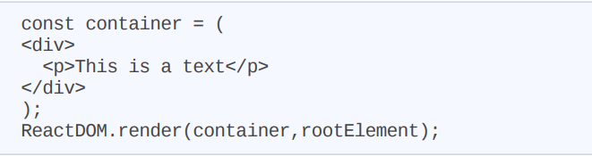
Using JSX, the above code can be simplified:

Slide 7
Why JSX? We understood what is JSX but why do we need it?
JSX makes the process simpler because it enables you to specify the UI in HTML. JSX has the full power of JavaScript, according to its developers
JSX enables React to display more informative error and warning messages for simpler debugging. JSX will throw an error your way if the HTML is incorrect or lacks a parent element so you can fix it right away.

Slide 8
JSX Rules
Return a Single Root Element
Use a single parent tag to contain all of the elements that the component returns.
Fragment component, which is frequently used with the <>...</> syntax, without enclosing them in another container element. It is not mandatory to use extra <div> to your markup, instead, you can use <> and </> .
Close All the Tags
camelCase
Use a JSX Converter
https://transform.tools/html-to-jsx

Slide 9
What is a Javascript Library?
A javascript library is a cluster of pre-written javascript code snippets that can be imported and used to perform common javascript functionalities easily. This promotes the reusability of code and hence faster development. The possibility of errors also becomes less as the code from libraries is generally well-tested
The concept of javascript libraries was initiated with the development of Jquery. JQuery was developed to simplify DOM manipulation, event handling, and AJAX. It helped in shortening the syntax and making code simpler

Slide 10
Note: Many times people get confused between a library and a framework. A library is a collection of code snippets that are used wherever required, while a framework is a foundation upon which an application is built. A library is called by our code, while a framework calls our code.

Slide 11
Single Page Applications
The upgradation of the JavaScript performance of web browsers gave birth to Single Page Applications (SPAs). A single-page application is a web application that works in a browser and does not require a page reload during use. It loads all the files on the initial load and then updates its DOM dynamically on user interaction
Working of Single Page Applications:
In Single page applications, the server sends an HTML file only on the first request. In all the subsequent requests, only data is passed to and from the server. The requests are sent with the use of AJAX.
JavaScript is used to define all the logic. Only the changes are rewritten on the page, and the complete page is not rerendered. This creates a seamless user experience.

Slide 12
There are several benefits that single-page applications provide:
They are smooth and fast. Hence they improve the application’s efficiency.
Their development process is easier.
Only content changes and the page remains the same. This creates a seamless user experience.
As SPAs use less bandwidth, hence everyone can use them conveniently without any issue with internet speed.
They are mobile-friendly. The frameworks that are used to create SPA can also help in the creation of mobile apps by reusing codes.

Slide 13
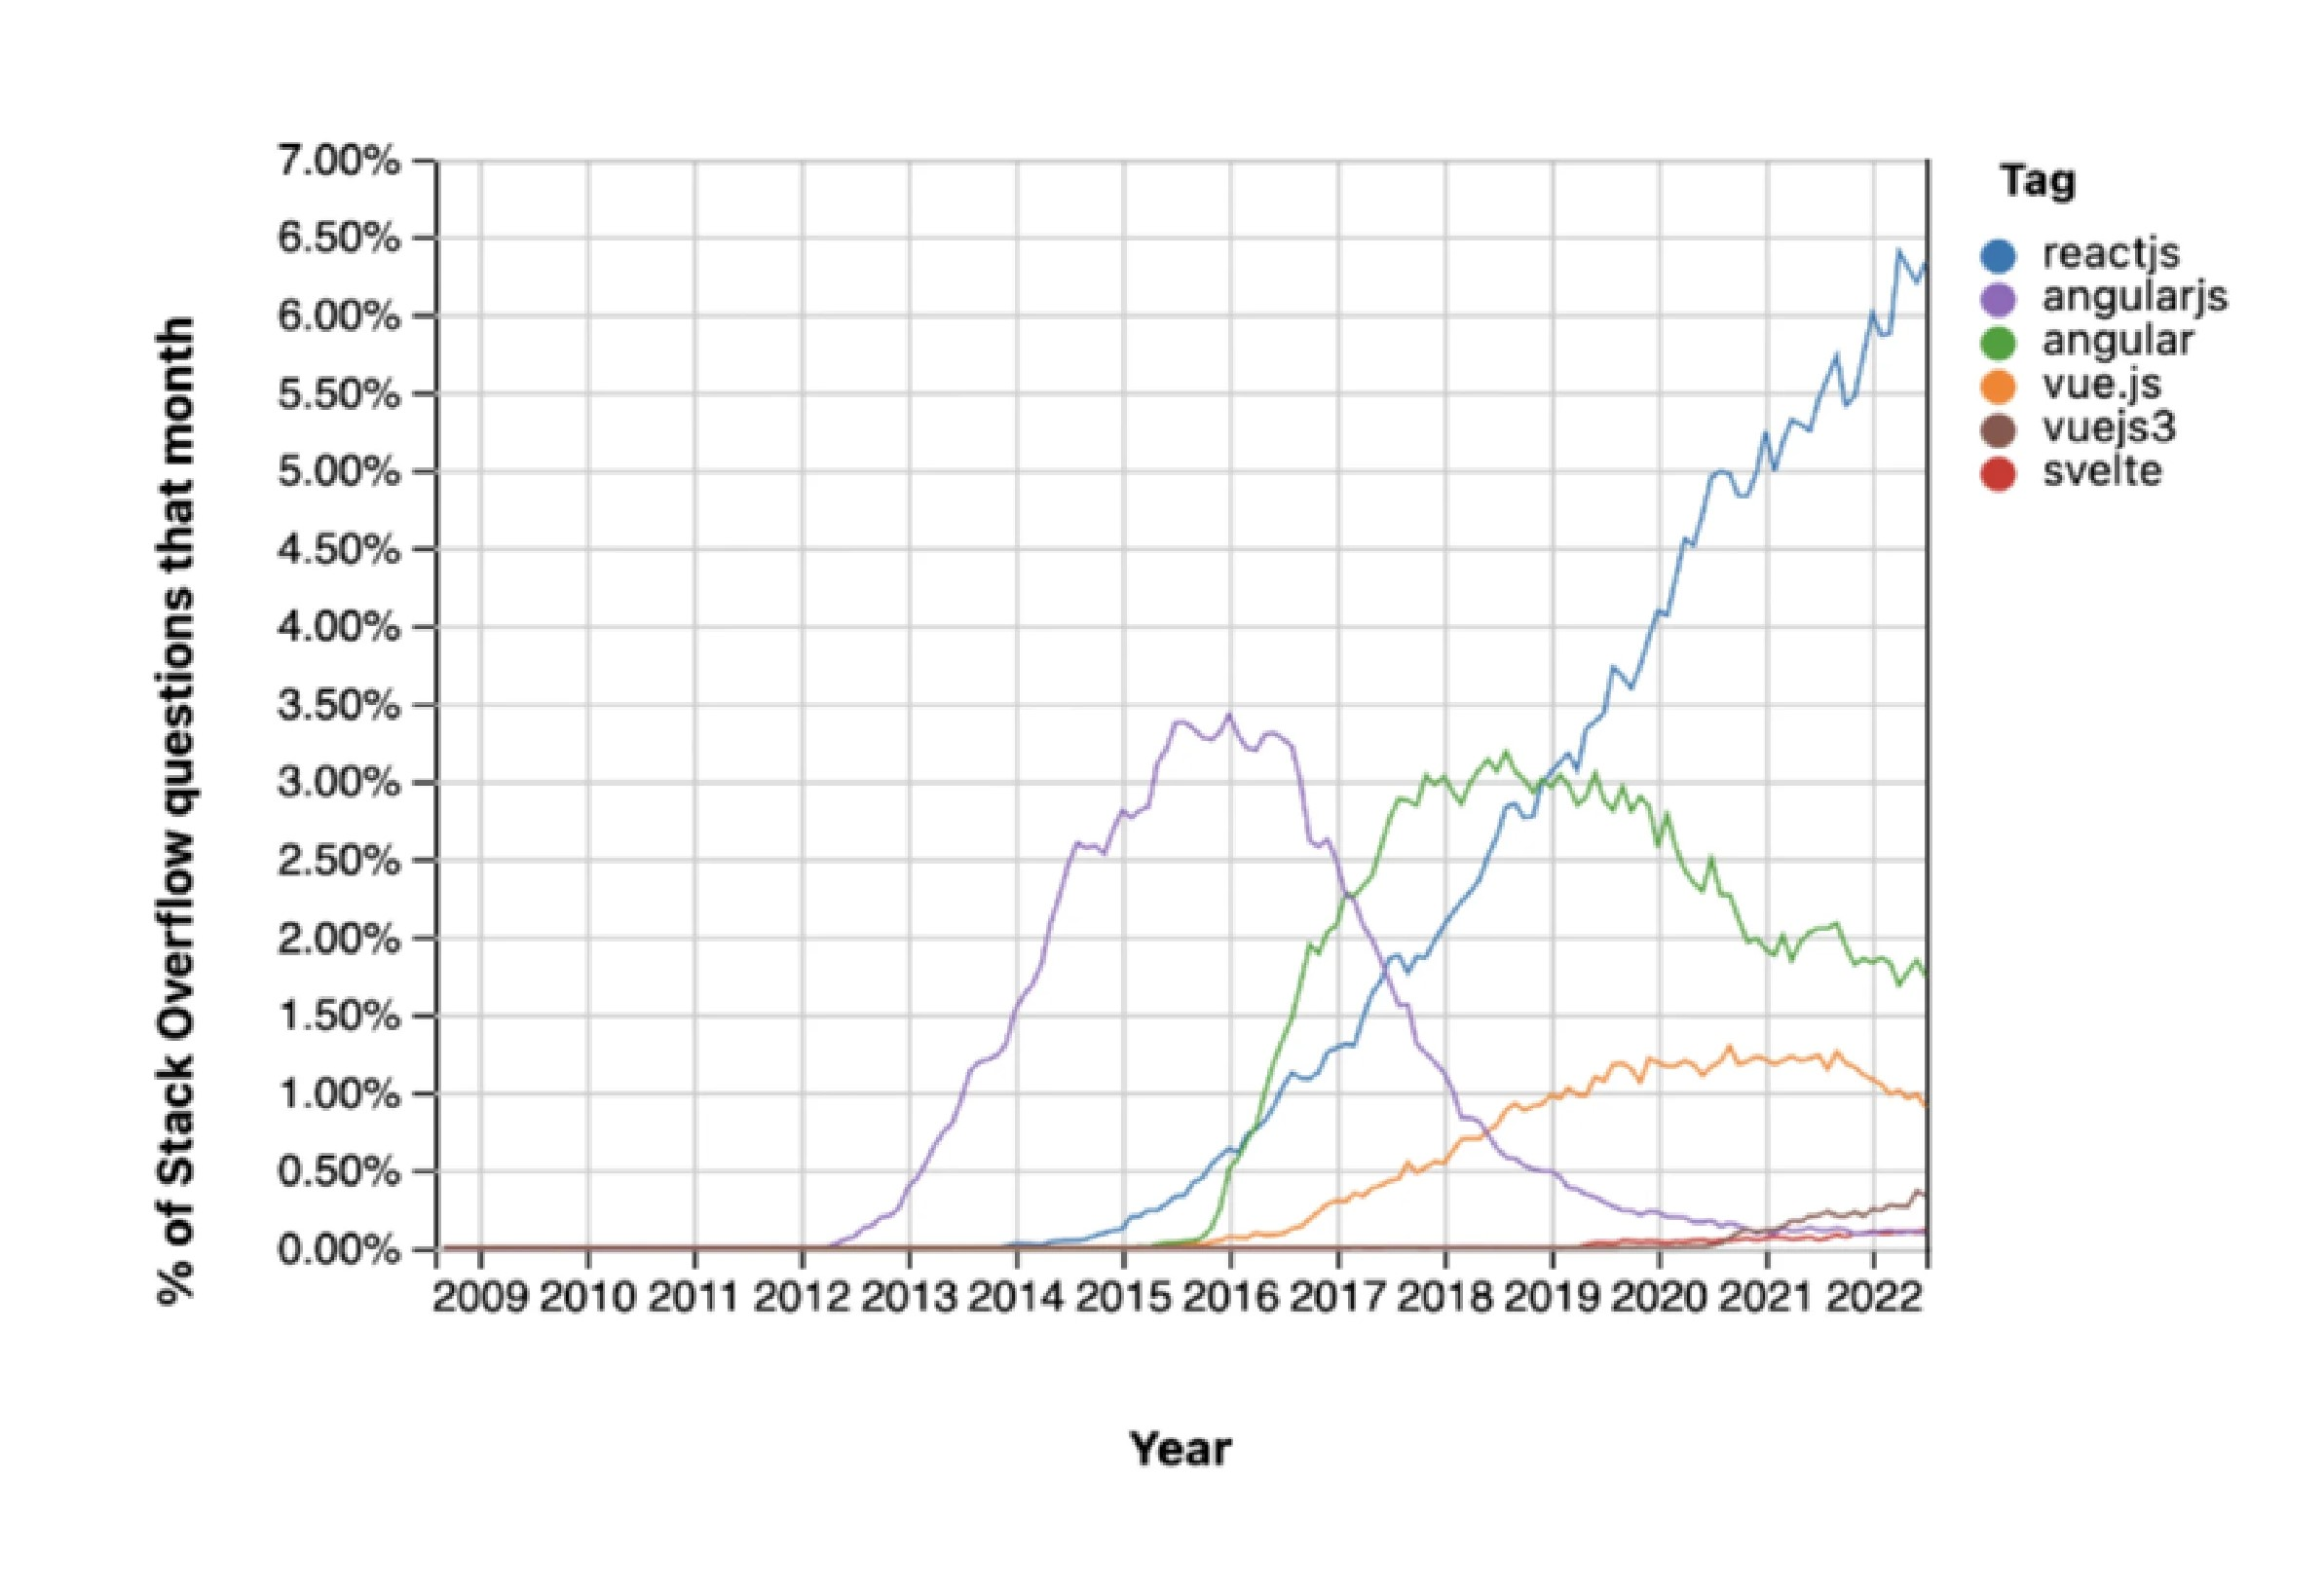
Should You Learn React JS?

Slide 14
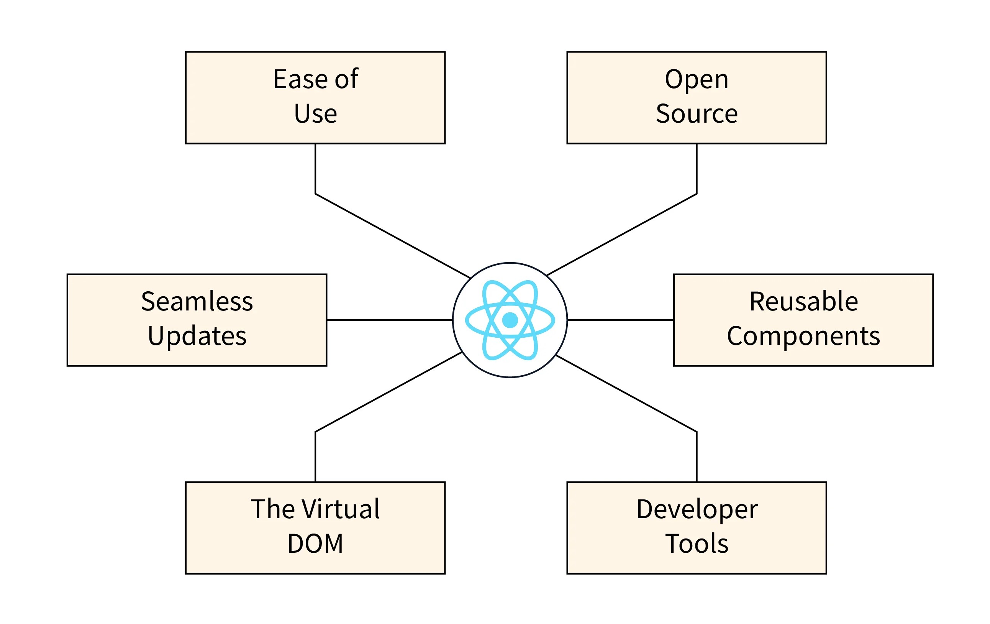
Why to Use React js for Web Development?

Slide 15
Reusable components
Fast Learning Curve
Flexibility and Compatibility
Virtual DOM
Extensive Toolset
React developer tools and Redux developer tools
JSX
Hooks
Global State management:
SEO friendliness

Slide 16
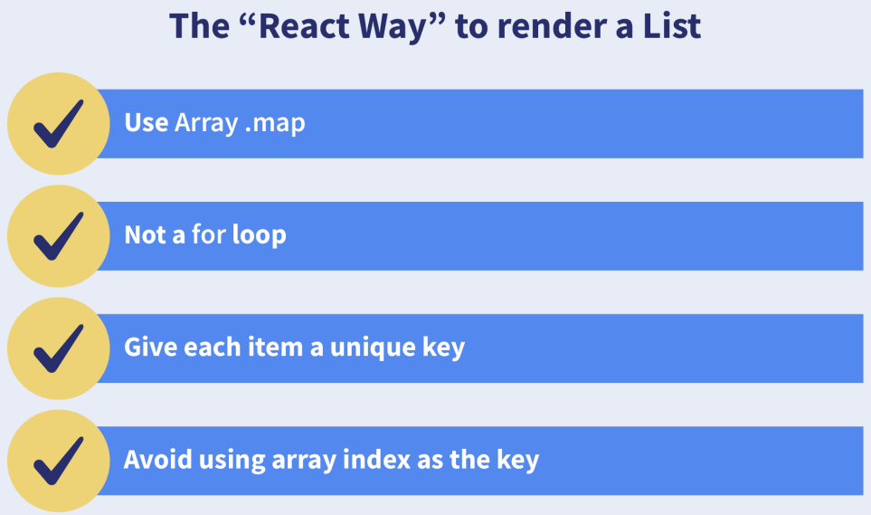
What are keys in React?
A key is a special string attribute that needs to be included when using lists of elements

Slide 17
Importance of keys -
Keys help react identify which elements were added, changed or removed.
Keys should be given to array elements for providing a unique identity for each element.
Without keys, React does not understand the order or uniqueness of each element.
With keys, React has an idea of which particular element was deleted, edited, and added.
Keys are generally used for displaying a list of data coming from an API
***Note- Keys used within arrays should be unique among siblings. They need
not be globally unique

Slide 18
What is the virtual DOM? How does react use the virtual DOM to render the UI?
As stated by the react team, virtual DOM is a concept where a virtual representation of the real DOM is kept inside the memory and is synced with the real DOM by a library such as ReactDOM
Why was virtual DOM introduced?
DOM manipulation is an integral part of any web application, but DOM manipulation
is quite slow when compared to other operations in JavaScript. The efficiency of the
application gets affected when several DOM manipulations are being done. Most
JavaScript frameworks update the entire DOM even when a small part of the DOM
changes

Slide 19
How does it work?
For every DOM object, there is a corresponding virtual DOM object(copy), which has
the same properties. The main difference between the real DOM object and the
virtual DOM object is that any changes in the virtual DOM object will not reflect on the
screen directly. Consider a virtual DOM object as a blueprint of the real DOM object.
Whenever a JSX element gets rendered, every virtual DOM object gets updated
**Note- One may think updating every virtual DOM object might be inefficient,
but that’s not the case. Updating the virtual DOM is much faster than updating
the real DOM since we are just updating the blueprint of the real DOM

Slide 20
React uses two virtual DOMs to render the user interface. One of them is used to store
the current state of the objects and the other to store the previous state of the
objects. Whenever the virtual DOM gets updated, react compares the two virtual
DOMs and gets to know about which virtual DOM objects were updated. After
knowing which objects were updated, react renders only those objects inside the real
DOM instead of rendering the complete real DOM. This way, with the use of virtual
DOM, react solves the problem of inefficient updating

Slide 21
React JS Examples Let’s now have a look at how to create a simple application with the use of ReactJS
To run a react application we must have Node.js
After installing Node version >= 14.0.0 and npm version >=5.6, we can easily create a react app using create-react-app. Run the following command the in terminal:
npx create-react-app sample-app
Now navigate to the sample-app directory using the command
cd sample-app
npm start

Slide 22
create-react-app, which includes all the necessary javascript packages that are required to run a react project (like webpack or Babel), and other packages like code transpiring, testing, basic linting, and build systems. Create-react-app also includes a server that features hot reloading that monitors the changes in the components and reflects them on your page without restarting the server.
README.md: It contains a summary of all the commands like the command to start the react app locally on your system. The information about the start, test, build, and eject scripts. For now, it is recommended not to edit the README.md file.
node_modules: This folder includes all the external javascript packages and file packages that are downloaded from npm and are used by your react project. This is rarely opened or changed

Slide 23
gitignore: The .gitignore is a file that includes some files and directories that your source control - git will not be tracked. The ignored terms include directories that are very large (node_modules) folders or API secrets that you do not need in the source control
public: This is a folder/ directory that includes all the static assets. It contains some basic HTML, JSON, images, svgs, and fonts for our react app. These are the roots of your folder.
src: This is a folder/ directory that includes our react javascript source code of your project. It is where all the react component and pages-related code will live and is what we will mainly work on to build our app
package.json: This file contains the meta-data of our react project, along it manages our app dependencies. It means all the packages present in the node_modules folder for your project, the title of the project, and version number, plus, most importantly, the scripts that we need to run and build our react app

Slide 24
React JS Community Resources
React popularity has grown steadily since 2015. It has a gigantic active community. Its GitHub Repository has over 40k forks and 195k Stars. It is one of the top repositories on GitHub.
Stackoverflow, one of the most popular websites among software developers, has more than lakhs of questions asked about React and its components and related libraries.
There are a lot of free and mature component libraries available online:
Microsoft has created the Fluent UI library to develop UI.
Material UI also offers many important React components.
React Bootstrap makes it easy to work with Bootstrap.
There are also some nature libraries that we can use we react, for example - ReactRouter, Redux, MobX, Jest, and GraphQL

Slide 25
Conclusion
A single-page application works in a browser and does not reload the page when later in use.
A SPA loads all the files on the initial load and then updates its DOM dynamically.
React is one of the best tools which helps in creating interactive applications for mobile, web, and other platforms.
React is a JavaScript library and not a JavaScript framework.
React offers us the feature to create separate UI components that have different functionalities.
Hooks make the state management of the React application quite easy.
React uses JSX JavaScript XML which makes it easier to write HTML in React.
React also offers SEO friendliness which in turn increases the page rank of a website.
One of the top five repositories on GitHub is React, hence it has huge community support

Slide 26
Intro to React Components
The fundamental unit of a React application is the React component. React components are basically blocks of code that can be reused and are independent in nature. Although they work independently and return HTML, they serve the same purpose as JavaScript functions
React components use three concepts to implement these features.
Properties- Allows the component to accept input.
Events- Make the component capable of controlling DOM events and user interaction.
State- Allows the component to continue being stateful. With regard to its state, a stateful component modifies its user interface.

Slide 27
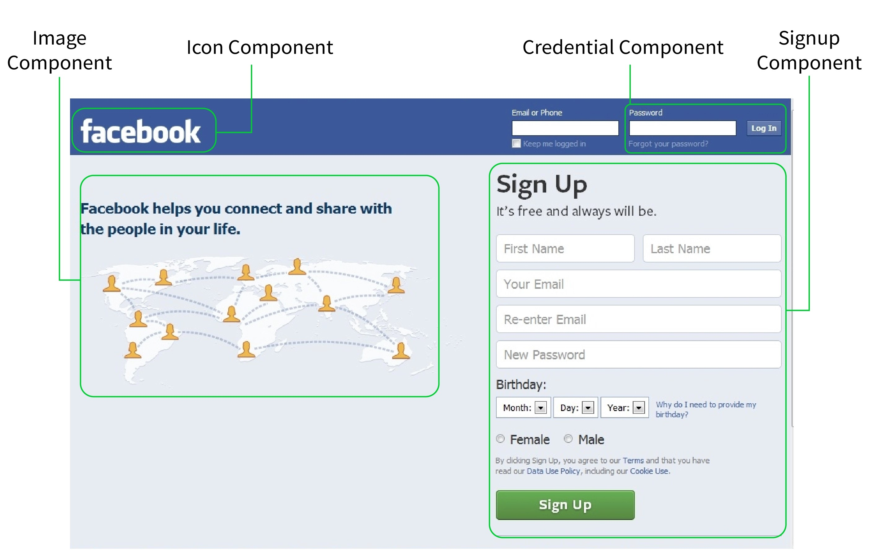

Slide 28
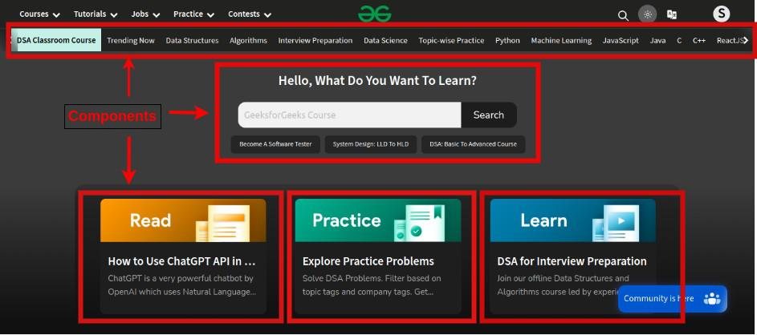

Slide 29
Functional Components
Functional components are simply JavaScript functions. We can create a functional component in React by writing a JavaScript function. These functions may or may not receive data as parameters, we will discuss this later in the tutorial. The below example shows a valid functional component in React:
function demoComponent() {
return (<h1>
Welcome Message!
</h1>);
}

Slide 30
Class Component
In comparison to functional components, class components are more complex. To develop class-based components in React, we can use JavaScript ES6 classes. To define a React component class, you need to extend React.Component. You must develop a render method that returns a React element by extending from React.Component. Data can be passed between classes and between class components.
class Welcome extends React.Component {
render() {
return <h1>Hello, {this.props.name}</h1>;
}
}

Slide 31
Rendering Elements
Elements are the smallest building blocks of React apps.
An element describes what you want to see on the screen:
const element = <h1>Hello, world</h1>;
React elements are plain objects. React DOM takes care of updating the DOM to match the React elements.
Let’s say there is a <div> somewhere in your HTML file:
<div id="root"></div>

Slide 32
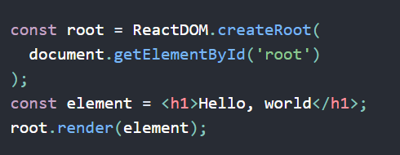
We call this a “root” DOM node because everything inside it will be managed by React DOM.
Applications built with just React usually have a single root DOM node. If you are integrating React into an existing app.
To render a React element, first pass the DOM element to ReactDOM.createRoot(), then pass the React element to root.render():

Slide 33
What are Props in React?
In React, we use props to transfer data across components (from a parent component to a child component ). Props is simply a shortened version of properties. They come in handy when you want your app's data flow to be dynamic.
You can only send props along the family tree in React. Only the children can receive information from a parent. Children are not allowed to pass objects up to their parents
Props are Read-Only:-
Whether you declare a component as a function or a class, it must never modify its own props

Slide 34
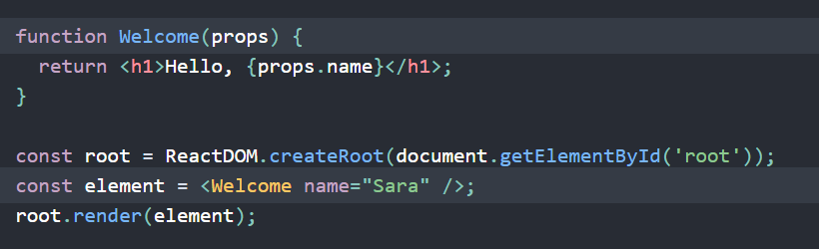
We call root.render() with the <Welcome name="Sara" /> element.
React calls the Welcome component with {name: 'Sara'} as the props.
Our Welcome component returns a <h1>Hello, Sara</h1> element as the result.
React DOM efficiently updates the DOM to match <h1>Hello, Sara</h1>.

Slide 35
ReactJS State
State in react refers to a JavaScript object that holds the changing data of any components and also keeps track of those changes over time between different renders. Because of the dynamic nature of the state, it allows users to make dynamic and more interactive web apps. We can use the state to take inputs and capture changing data from API's.
Generally, class components use the state property, while the function component use hooks(useState()) to manage the state.

Slide 36
Creating the State Object
State object for class based components is initialized in a constructor
// state object is always declared in the constructor
constructor(props) {
// parent constructor is called using super
super(props);
// declaring the state object attributes and their respective values
this.state = {
attribute : "value"
};
}

Slide 37
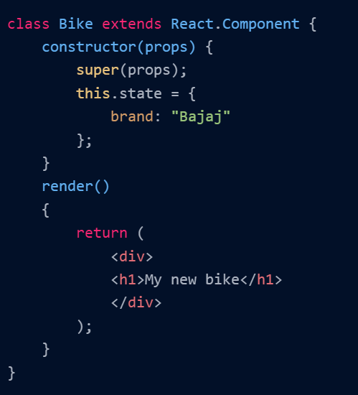

Slide 38
Using the State Object:- this.state.propertyname
Changing the State Object(classComponent)
Few important points related to the state object of the class components :
React re-renders a component to the browser whenever the state object of that component changes.
The state object holds dynamic value and can be changed by the user.
The state object is defined in the constructor of the class.
The state object is used to store different and multiple attributes.
To change the value of an attribute of the state object, we use this.setState().

Slide 39
Using the State Hook Hooks are a new addition in React 16.8. They let you use state and other React features without writing a class.
A Hook is a special function that lets you “hook into” React features. For example, useState is a Hook that lets you add React state to function components. We’ll learn other Hooks later.
When would I use a Hook? If you write a function component and realize you need to add some state to it, previously you had to convert it to a class. Now you can use a Hook inside the existing function component. We’re going to do that right now!
Note:
There are some special rules about where you can and can’t use Hooks within a component.

Slide 40

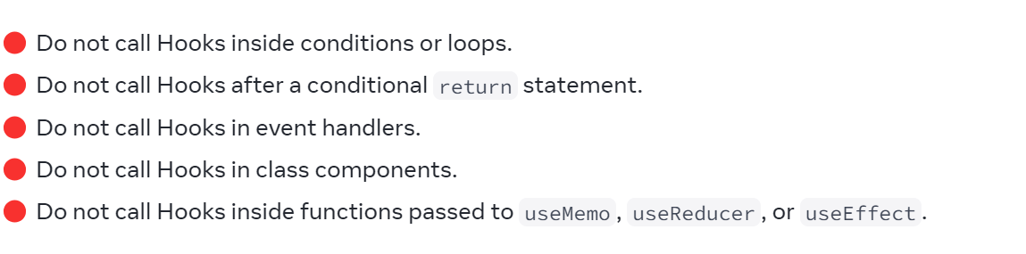
Rules of Hooks

Slide 41
What is useState() in React?
The useState() is a built-in React Hook that allows you for having state variables in
functional components. It should be used when the DOM has something that is
dynamically manipulating/controlling.
In the below-given example code, The useState(0) will return a tuple where the count
is the first parameter that represents the counter’s current state and the second
parameter setCounter method will allow us to update the state of the counter.
const [count, setCounter] = useState(0);
const [otherStuffs, setOtherStuffs] = useState(...);
const setCount = () => {
setCounter(count + 1);
setOtherStuffs(...);
};

Slide 42
We can make use of setCounter() method for updating the state of count anywhere.
In this example, we are using setCounter() inside the setCount function where various
other things can also be done. The idea with the usage of hooks is that we will be able
to keep our code more functional and avoid class-based components if they are not
required.

Slide 43
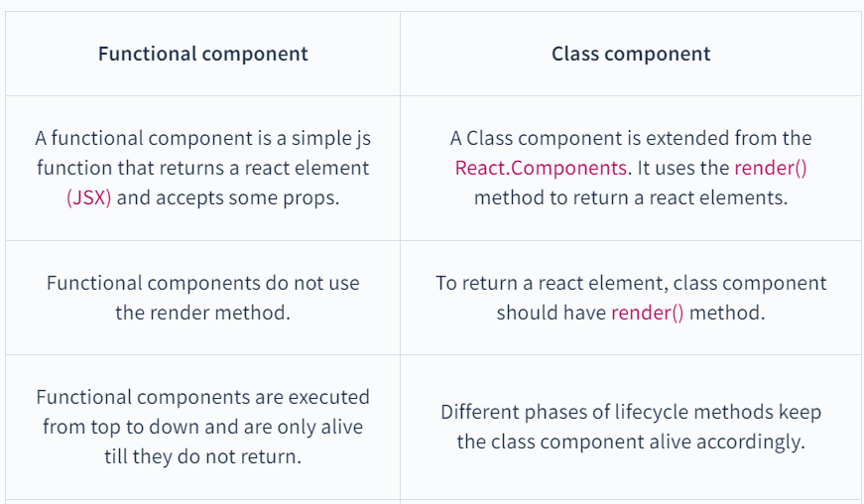
comparison between the class and functional components

Slide 44
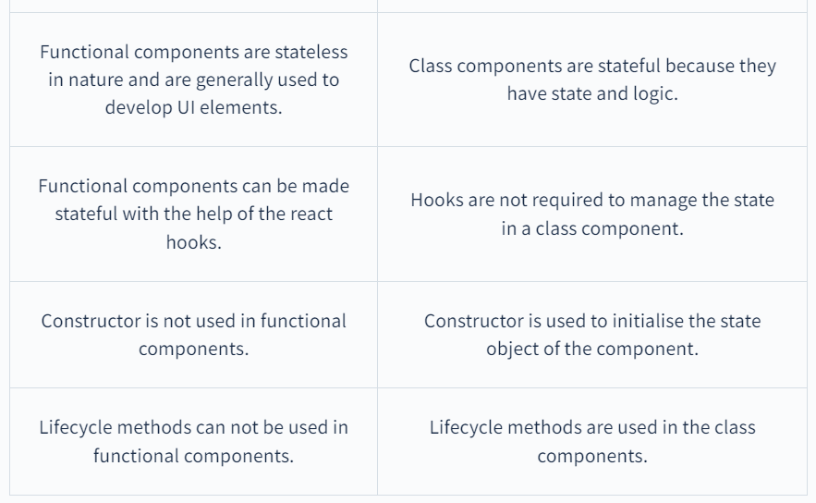

Slide 45
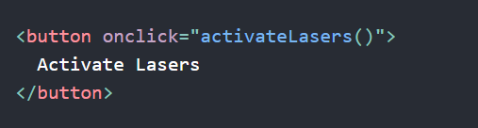
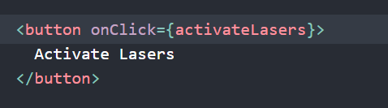
ReactJS Handling Events
Handling events with React elements is very similar to handling events on DOM elements. There are some syntax differences:
React events are named using camelCase, rather than lowercase.
With JSX you pass a function as the event handler, rather than a string.

Slide 46
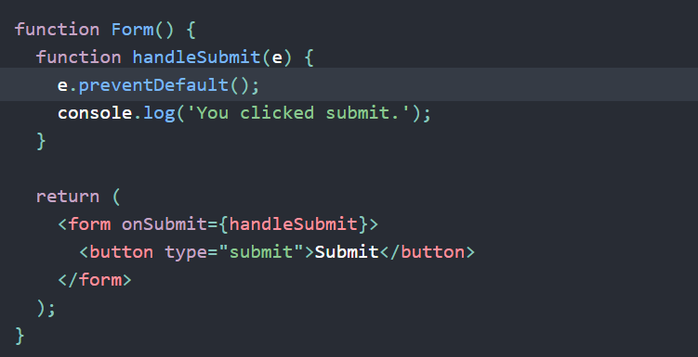
Another difference is that you cannot return false to prevent default behavior in React. You must call preventDefault explicitly

Slide 47
Conditional Rendering React
Your components will often need to display different things depending on different conditions. In React, you can conditionally render JSX using JavaScript syntax like if statements, &&, and ? : operators.

Slide 48
Working with List and Key Prop in React
Lists are the most common component in react and can take a toll on the app’s performance if not used correctly. Because performance is one of the most important parameters, when you are using lists, you need to develop components correctly. React provides us with key props in the list, to optimize the performance
Key:-React uses keys to pinpoint which of the elements in the list collection is changed and needs to be re-rendered instead of re-rendering the whole collection. Therefore boosting the performance of the react application. That's why we will be learning how to correctly design list components in JSX and the best practices that should be followed.

Slide 49
function ListComponent(props) {
const items = props.items
//making a list by traversing through the collection
const listItems = items.map((item) => (
// adding the key prop for the uniqueness of every item
<li key={item.toString()}>{item}</li>
))
//returning the list
return <ul>{listItems}</ul>
}
Keys are required by react to uniquely identify every component of the list for optimal performance re-rendering. Keys help react pinpoint the item in a list that has been removed, changed, or updated.

Slide 50
How Does React Key Attribute Work?
Keys are always in string format and should be given to every element to give them a unique identity
const mylist = [100, 200, 300, 400, 500]
const listItems = mylist.map((list) => (
<li key={list.toString()}>{list}</li>
))
We should always choose a field that is unique for every react list element so that the key uniquely pinpoints a list item among its siblings. Like in the case of the database, we have a unique ID

Slide 51
const ItemComponent = mylist.map((list) => (
// unique ID is best for key props
<li key={list.id}>{list.number}</li>
))
At last, we can use the index as a key, but it is not recommended as it hurts the performance of the react app
const ItemComponent = mylist.map((list, index) => (
//This is only to be done in case items have no stable IDs
<li key={index}>{list.number}</li>
))

Slide 52
Extracting Components with Keys
Keys are only meaningful in the context of the surrounding collection. Let us see the incorrect and correct ways to extract an element from a list. Consider a case where you have a Component to return the different list items of a collection. In that case, you need to assign the key prop to that <Component /> and not the <li> inside that component.

Slide 53
Inline CSS.
Styling in React Using CSS
Remember that React uses JSX and not HTML. Inline styling in JSX is a little different, here are a few things we should keep in mind:
camelCased Property Names
In CSS if the property consists of two words then they are separated by a dash - but in JSX this is not the case. For example, If we want to use the background-color property then we will use camelCase and it will look like backgroundColor

Slide 54
JavaScript Object
The style attribute takes an object as an argument.
In JavaScript, objects are written inside curly braces {} and to use JavaScript expression inside JSX we need a pair of curly braces {}. So, to use inline styles in JSX we have to write the style inside two curly braces {{}}
Now it’s the time for pros and cons of Inline Styles
PROS
Higher precedence
Simple to use
Suitable for small projects
CONS
Code becomes unreadable
Cannot use animations, selectors, etc.
Not scalable
Lot of code repetition

Slide 55
CSS Stylesheet
In React we can use CSS stylesheets. CSS stylesheet is a file with a .css extension that stores all the styles. We can then refer to the styles from this file.
Suppose we have a CSS file with the name styles.css and we have defined a simple style inside it
.mainDiv {
background-color: darkcyan;
width: 30vw;
min-height: 20vh;
}
In JSX we do not use the class keyword as we do in HTML to refer to CSS classes because class is a reserved keyword in JavaScript, instead we use className to refer to CSS classes

Slide 56
CSS Modules
CSS module is a different approach to include CSS in React Apps. CSS modules turn CSS into the local scope which means that the CSS scoped to that particular component and the file
CSS modules generate styles dynamically for a particular component
Pay attention to CSS filename ${your_name}.module.css - this is required.

Slide 57
Coming to Pros and Cons of CSS modules
PROS
Code is written like normal CSS
No setup is required
Clean code
Locally scoped styles
CONS
For Typescript we have to generate interfaces
Tricky to reference classnames

Slide 58
Tailwind CSS in React
Tailwind CSS is a utility-first approach.
But what is a utility-first approach? This utility-first approach offers basic utility classes that enable us to create entirely custom designs without ever leaving your HTML. CSS
Tailwind provides us with utility classes that we can use directly with JSX; thus, we do not need to write any CSS. Tailwind is a full CSS framework that supports grids, flex, etc

Slide 59
The Effect Hook lets you perform side effects in function components:

Slide 60
What is the useEffect cleanup function?
The useEffect cleanup is a function in the useEffect Hook that allows us to tidy up our code before our component unmounts. When our code runs and reruns for every render, useEffect also cleans up after itself using the cleanup function.
The cleanup function prevents memory leaks and removes some unnecessary and unwanted behaviors.
useEffect(() => {
effect
return () => {
cleanup
}
}, [input])

Slide 61
The useEffect cleanup function does not only run when our component wants to unmount, it also runs right before the execution of the next scheduled effect.

